Slide 1

12/4/14
Team:
DingoHub
(How Do You Turn This On?)
ZACH DIEMER • TAYLOR EREIO • ALI HAMIE • RICARDO NORIEGA
Notes:
Taylor

Slide 2
OVERVIEW
Current Social Networks
What is Hubbub?
How Hubbub works
Where do we go from here?
HUBBUB :: ZACH DIEMER • TAYLOR EREIO • ALI HAMIE • RICARDO NORIEGA
Notes:
Taylor

Slide 3
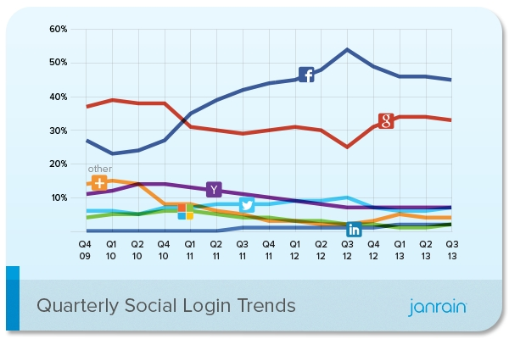
CURRENT SOCIAL NETWORKS
How do current social networks fall short?
HUBBUB :: ZACH DIEMER • TAYLOR EREIO • ALI HAMIE • RICARDO NORIEGA
Notes:
Facebook sucks
Taylor

Slide 4
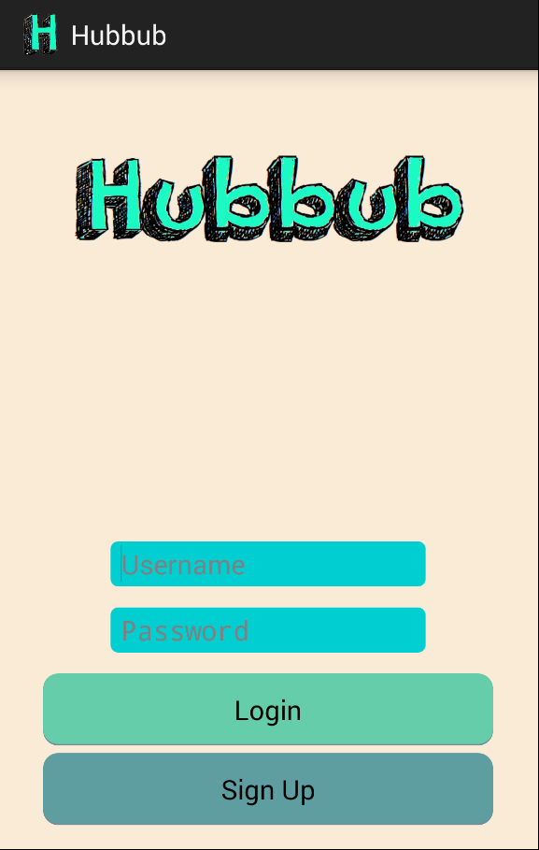
WHAT IS HUBBUB?
Hubbub is a social event sharing application
Intended for those who want to meet like-minded individuals who share a common interest
Initially targeted for the Android platform
HUBBUB :: ZACH DIEMER • TAYLOR EREIO • ALI HAMIE • RICARDO NORIEGA
Notes:
Zach

Slide 5
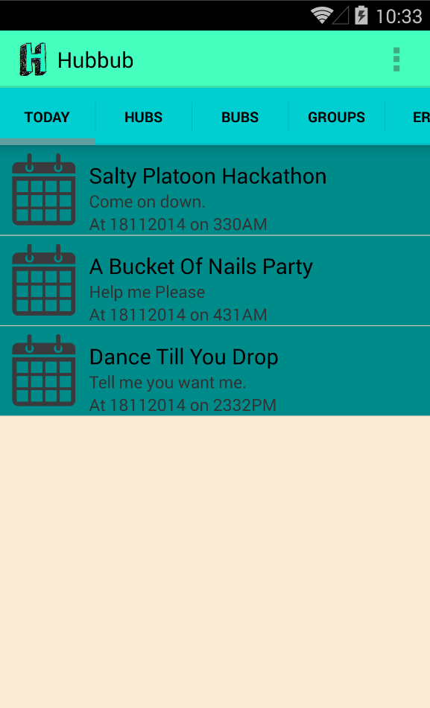
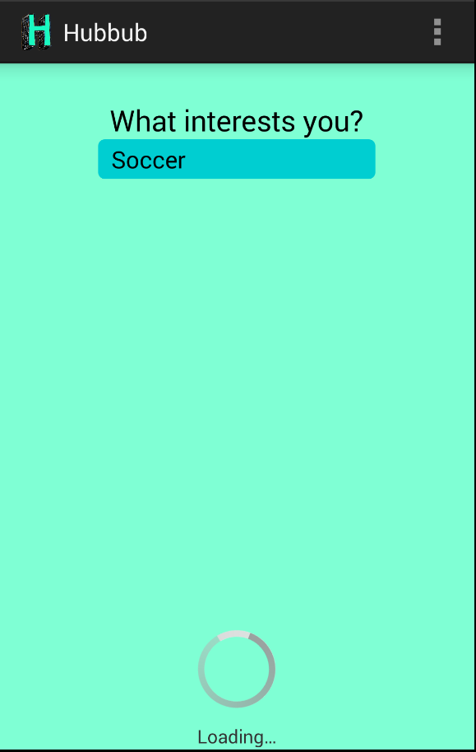
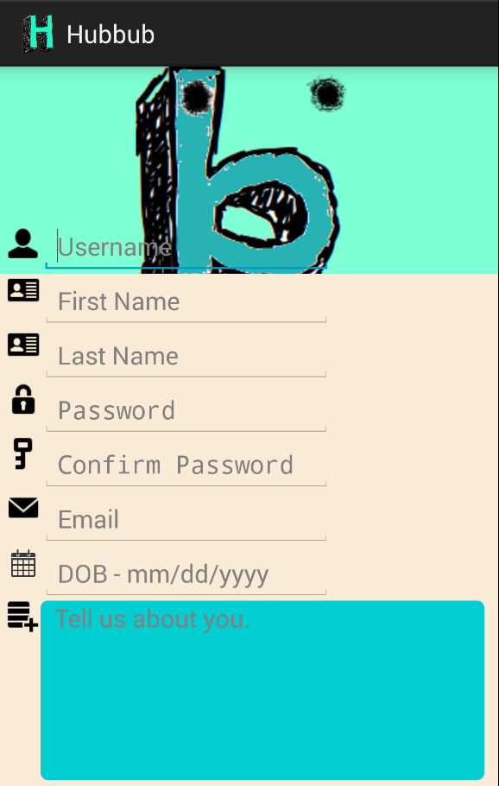
WHY HUBBUB?
What Makes Hubbub Unique?
Today’s Events Tab
HUBBUB :: ZACH DIEMER • TAYLOR EREIO • ALI HAMIE • RICARDO NORIEGA
Notes:
Zach

Slide 6
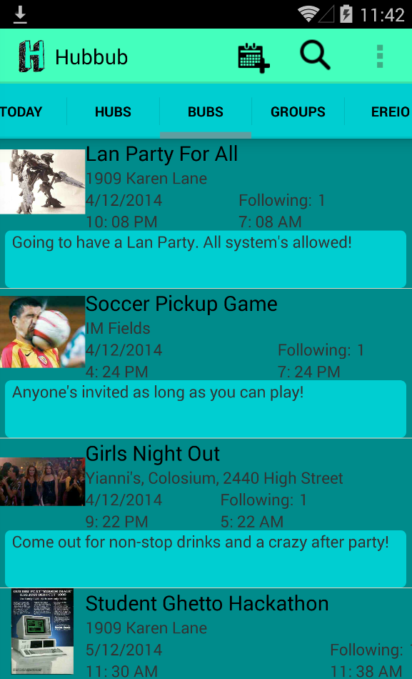
HOW HUBBUB WORKS - CORE FUNCTIONALITY
Hubbub is centered around two things:
“Hubs” and “Bubs”
Hubbub aims to make event planning a more social process
What are Hubs?
What are Bubs?
HUBBUB :: ZACH DIEMER • TAYLOR EREIO • ALI HAMIE • RICARDO NORIEGA
Notes:
Zach

Slide 7
HOW HUBBUB WORKS - MORE ON BUBS
Bubs are user created events tagged to Hubs
Users can only see and follow Bubs posted in the same physical area
Users define the following characteristics of a Bub:
Time
Location
Max/min capacity
Private/public event
HUBBUB :: ZACH DIEMER • TAYLOR EREIO • ALI HAMIE • RICARDO NORIEGA
Notes:
Ali

Slide 8
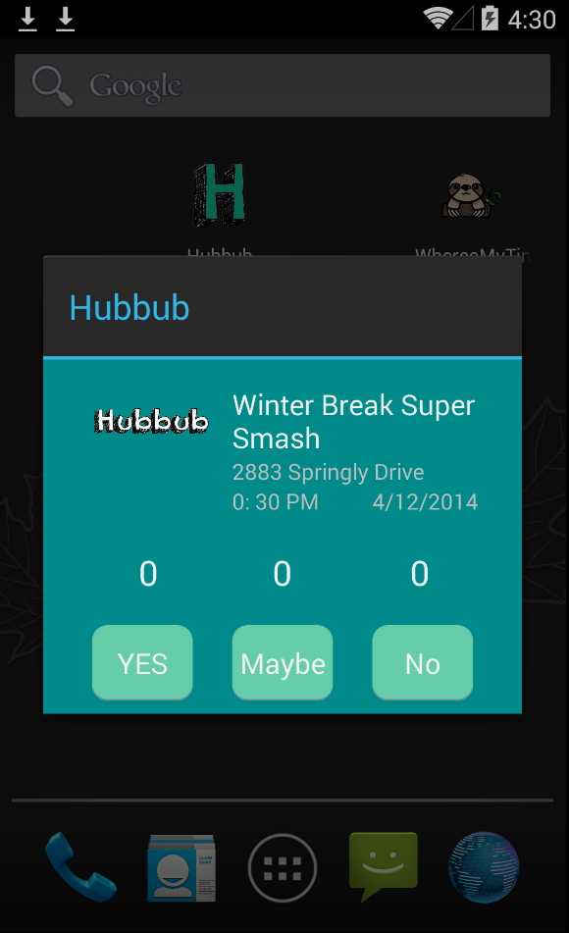
HOW HUBBUB WORKS - MORE ON BUBS
Ping-In
A massive push notification
The creator of a Bub can set ping-ins
Attendees see the ping-in data in real-time
Posts
Live chat attached to each Bub
HUBBUB :: ZACH DIEMER • TAYLOR EREIO • ALI HAMIE • RICARDO NORIEGA
Notes:
Ali

Slide 9
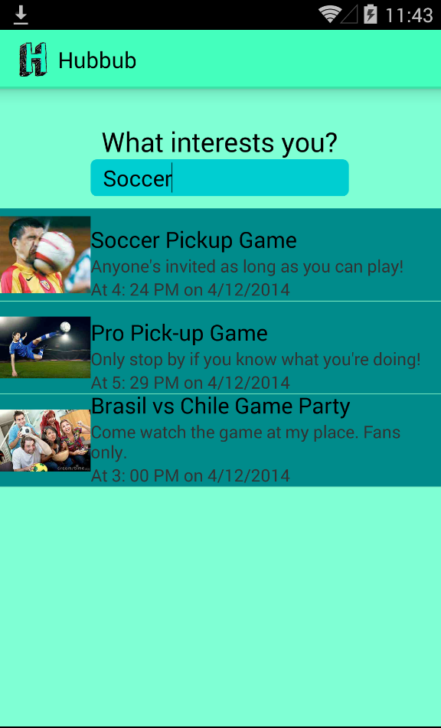
HOW HUBBUB WORKS - MORE ON HUBS
Hubbub is GeoFenced
Only users within a certain city or town can see events around them.
Default or generic Hubs (i.e soccer, football...)
All users have the ability to create new Hubs
Users can follow a Hub to see all relevant Bubs
HUBBUB :: ZACH DIEMER • TAYLOR EREIO • ALI HAMIE • RICARDO NORIEGA
Notes:
Ali

Slide 10
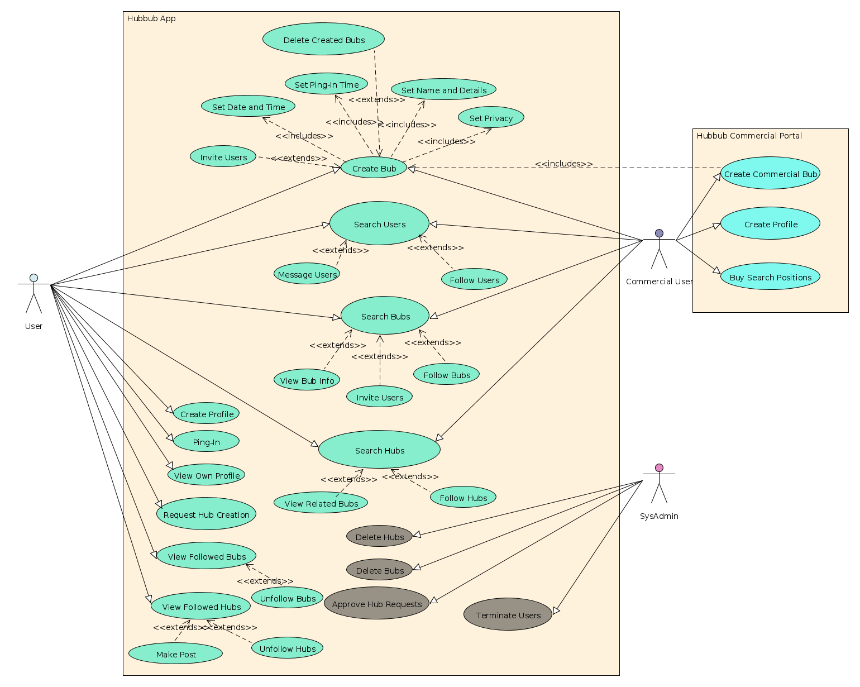
HOW HUBBUB WORKS - USE CASE
HUBBUB :: ZACH DIEMER • TAYLOR EREIO • ALI HAMIE • RICARDO NORIEGA
Notes:
Ricardo

Slide 11
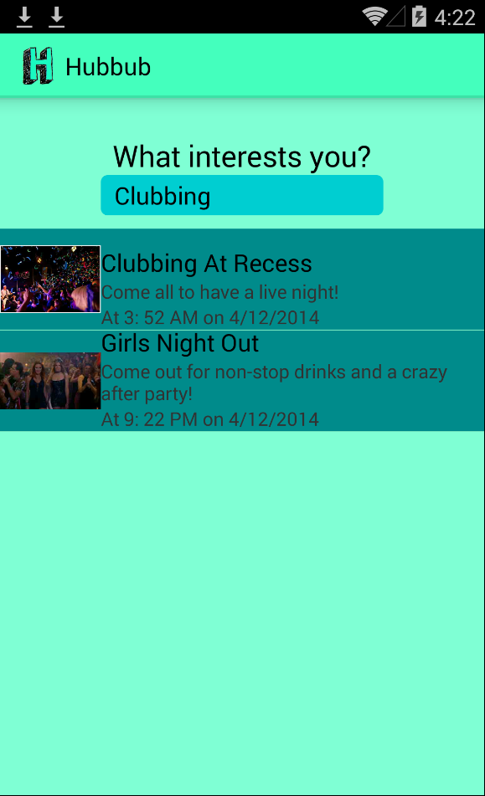
CORPORATE/ADVERTISING PARTNERS
Advertising
Allow Commercial Users to develop presence in community
Advertising Premiums
Community
Fostering community interaction
Real Time Interest
HUBBUB :: ZACH DIEMER • TAYLOR EREIO • ALI HAMIE • RICARDO NORIEGA
Notes:
Ricardo

Slide 12
Incremental Development Goals
1) Android
Minimum and required development for CEN4020 & 4021 class
2) iOS
Team goal for scheduled release on or around CEN4021 due date
3) Web App
Release goal for the application and network itself
HUBBUB :: ZACH DIEMER • TAYLOR EREIO • ALI HAMIE • RICARDO NORIEGA
Notes:
Taylor

Slide 13
WHERE DO WE GO FROM HERE?
Hubbub aims to refine how current social networks implement event planning
Hubbub is focused on real life interaction.
Hubbub implements unique features such as geofencing and ping-ins
HUBBUB :: ZACH DIEMER • TAYLOR EREIO • ALI HAMIE • RICARDO NORIEGA
Notes:
Taylor

Slide 14
REFERENCES
http://mashable.com/2014/03/19/google-facebook-dominate-mobile-ads/
http://www.dragonsearchmarketing.com/problem-with-facebook-event-invitations/
http://techcrunch.com/2013/09/18/facebook-doesnt-want-to-be-cool/
http://blogs.telegraph.co.uk/technology/jackrivlin/100010603/revealed-why-we-hate-facebook/
HUBBUB :: ZACH DIEMER • TAYLOR EREIO • ALI HAMIE • RICARDO NORIEGA
Notes:
Taylor

